Slide 2
Chapter 8
Virtualization Technology (At Desktop and Application)

Slide 3
Learning Outcomes
Comprehend desktop virtualization
Describe techniques used for desktop virtualization
Illustrate remote desktop services
Explain hardware virtual machine
Understand infrastructure of desktop virtualization
Describe components of desktop virtualization
Describe machine imaging
Describe VM migration services management

Slide 4
Introduction
Desktop virtualization is actually a type of illusion provided to the user using different techniques.
It involves encapsulating and delivering either access to an entire information system environment or the environment itself to a remote client device.
For IT organizations, desktop administration is expensive, manual, and time-consuming.
As compared to desktop virtualization, server virtualization makes datacenters more quick and effective by advanced levels of accessibility, quicker application delivery, and enhanced utilization.

Slide 5
Desktop Virtualization
Desktop virtualization is a type of software technology used to separate the desktop and its connected application software from the physical device used by the client.
Remote desktop virtualization works in a manner similar to client–server model in which applications can be executed on any remote desktop with different operating systems and with the help of the protocol of remote display, a user can interact with the application as shown in Fig. 8.1.
In a virtualized desktop, virtualization breaks the connection between hardware and the elements facilitate the IT staff to alter, update, and organize these elements independently for greater business quickness and improved response time.

Slide 6
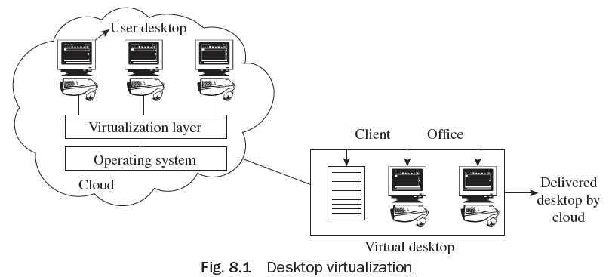
Desktop Virtualization

Slide 7
Advantages of Desktop Virtualization
Simpler provisioning of new desktops
Installation of new applications at cheap rates
Desktop image-management capabilities
Increased data security
Longer time given for customer desktop infrastructure
Protected reserved access to a business’ desktop settings

Slide 8
Advantages of Desktop Virtualization
Facilitation of thin clients
Improved security
Better business continuity and disaster recovery
Abridged PC repairs
Suppleness of access
Improved deployment and management

Slide 9
Features of Desktop Virtualization Drivers
Reduction in cost of desktops
Reduction in management cost of desktop
Easy setting of desktops
Reduced cost to refresh desktops

Slide 10
Techniques used for Desktop Virtualization
The two desktop virtualization techniques basically used for providing services to users are as follows:
• Remote desktop services (RDS)
• Virtual desktop infrastructure (VDI)
VDI and RDS are designed for providing services to users as per their requirement.

Slide 11
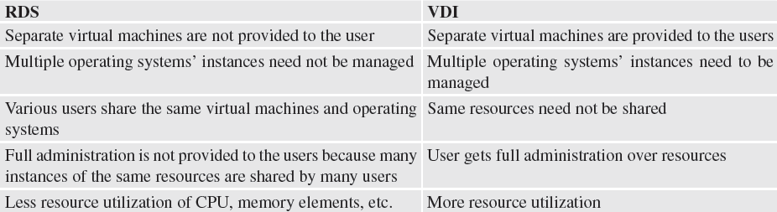
Differences between RDS and VDI

Slide 12
Remote Desktop Services
Remote desktop services (RDS) is customarily called terminal services. It is a blanket term for characteristics of Microsoft Windows server which permits consumers to distantly access Windows applications and graphical desktops.
The advantages of RDS are as follows:
Data recovery in tragedy
Operation from anyplace
Economical

Slide 13
Remote Desktop Services
The disadvantages of RDS are as follows:
Requirement of powerful RDS
Requirement of RDS monitoring
Requirement of reliable network
Requirement of right adjustment in network
Knowledgeable administrator

Slide 14
Virtual Desktop Infrastructure
Virtual desktop infrastructure (VDI) refers to the hosting of a desktop OS running in a VM on a server in the virtual data center (VDC).
VDI allows a user to access a remote desktop environment from an endpoint device via a remote desktop delivery protocol.
The VDI architecture consists of several components that work together to provide an end-to-end solution.

Slide 15
Virtual Desktop Infrastructure
Advantages of VDI are:
Low price in buying desktop computers
Centralized client operating system management
Swift client implementation
Reduction in the costs of desktop
Reduction in the cost of electricity
Enhanced security of data
Protected remote access
Lesser applications compatibility troubles

Slide 16
Virtual Desktop Infrastructure
Disadvantages of VDI are:
Printing normally involves third-party appends
Scanning is natively unsupported
Bi-directional audio is natively unsupported
Exhibit protocols are unsuitable for graphic design
Needs low-latency association between the virtual infrastructure and customer
Needs enterprise class server hardware and storage areas network for VMs permanently delivered to particular users
Needs trained IT staff

Slide 17
Components for Desktop Virtualization
The VDI architecture consists of several components that work together to
provide an end-to-end solution. The main components are:
• Endpoint devices
• A connection broker
• VM hosting

Slide 18
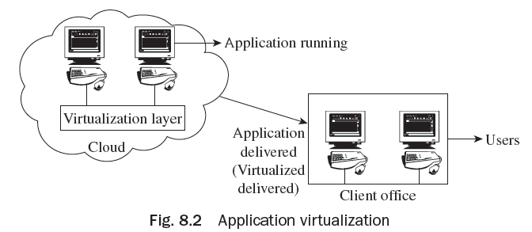
Application Virtualization
Application Virtualization technology offers skills to install applications without altering or making any variation to the file system, underlying OS, or registry of the computing platform in which they are installed as shown in Fig. 8.2.

Slide 19
Application Virtualization
Technology categories that fall under application virtualization include the following:
• Streaming of application: Before startup, rather than delivering the whole application, portions of the application’s code, settings, and data are delivered according to their requirement.
• VDI or desktop virtualization: The application is introduced in blade PC or VM which also comprises the operating system (OS). This makes management of infrastructure and formation of virtual desktops easy to grant access of virtual desktops. VDI may normally fill up the gaps wherever applications’ streaming fails.

Slide 20
Application Virtualization
Advantages of Application Virtualization:
Improved workload management
Reduced hardware cost
Increased flexibility for working remotely
Simplified application deployment: Applications are never installed on to an operating System; hence the deployment of the applications is greatly simplified. Furthermore, complete removal of all application bits from a PC during retirement is assured.

Slide 21
Application Virtualization
Simplified operating system image management: Since applications are completely different from the OS, managing OS images is simpler, especially during OS patches and upgrades. It helps to create a more dynamic desktop environment, in which the desktop is an aggregation of separately managed components.
Elimination of resource conflicts: Since each application has its own virtual OS resources, resource and application conflict issues are eliminated.

Slide 22
Application Virtualization
Limitations of Application Virtualization:
All software cannot be virtualized. For example, applications that require a device driver or 16-bit applications that require shared memory space cannot be virtualized.
Some types of software cannot be virtualized, such as anti-virus packages and applications that require heavy OS integration.

Slide 23
Tools used for Application Virtualization
The tools for application virtualization include:
Microsoft Application Virtualization (App-V)
VMWare ThinApp
Flexera Software Supporting Application Virtualization

Slide 24
Hardware Virtual Machine
Hardware virtualization technique is used to make a physical machine a virtual machine.
Hardware virtualization is a developing technology which can turn out to be foremost, particularly for server platforms.
Virtual machines, along with hardware editions earlier than edition 8, may work on ESXi 5.0 hosts but do not encompass all the facilities accessible in hardware edition 8.
A VM is described as a physical machine by software which has its individual array of virtual hardware on which an application and operating system may be overloaded.

Slide 25
Porting Application
Porting is a method of making software adaptive to every situation for which it was not initially written or planned to perform.
It is also compatible with different hardware configurations.
The three favored platforms are those from UNIX, Apple, and Microsoft, making it simpler to build software that is transferable.
Customer requirements and platforms are generally different from each other, but for availing services of the cloud environment, customers have to interact with the cloud services provided by the cloud providers.

Slide 26
Virtual Machine Migration Services Management
Virtual machine migration is mostly done for dynamic resource administration.
Its chief aims are:
Load balancing
server consolidation
coldspot and hotspot mitigation.

Slide 27
Thank You!

